Slide 1

To insert your company logo on this slide
From the Insert Menu
Select “Picture”
Locate your logo file
Click OK
To resize the logo
Click anywhere inside the logo. The boxes that appear outside the logo are known as “resize handles.”
Use these to resize the object.
If you hold down the shift key before using the resize handles, you will maintain the proportions of the object you wish to resize.
Enron Finland Energy
&
Vneshtopprom Exposure Analysis
Confidential/Attorney Client Privilege

Slide 2
Background to Current Exposure
Helsinki entered into fixed price transactions with Vneshtopprom and London put on financial hedges against that fixed price exposure (Contracts dated April 30th, May 5th, June 8th)
Prepayments were made against these fixed price contracts as well as contracts agreed on a floating price basis
Deliveries were not up to contractual volume, and undelivered volume was rolled forward as were the financial hedges against that volume
Inquiry began in late October 1999, when Finland trader called London trader asking her to roll large financial hedge position “quietly”
In November 99, senior Europe management prohibited new prepayments and charged commercial head of trading with negotiation and recovery of both the mark to market and prepayment exposure
During negotiations in January 2000, Vneshtopprom made accusations that Helsinki had altered delivery documentation [Bills of Lading] and disputed the amount owed

Slide 3
Altered Bills of Lading
Altered Bill of Lading activity had been discovered in February 99 by Kevin Sweeney, and communicated to Kevin Beasley, David Mally, and Graham Cane
Orders were issued to cease any activity of that kind to Helsinki commercial and support staff
Senior Europe management were unaware of this when they reviewed the Vneshtopprom situation in November 99
Estimated claim by Vneshtopprom $0.75m - $2.4m*
Estimated potential claims by other counterparties $0.8m - $2.1m*
* Based on information to date
Notes:
##
*
*
07/16/96

Slide 4
Exposure Analysis - 12/31/99
(In USD million)
Vneshtopprom Maximum Exposure Expected Loss
  Outstanding Pre Financing Balance 4.3* 4.3*
  Gross MTM recognised on fixed price deals 11.9 11.9
  Gross Exposure 16.2 16.2
  Less Balance written off in November and December 1999 (2.5) (2.5)
  Total Remaining Vneshtopprom Exposure 13.7** 13.7**
Other Potential Exposure Items - (Maximum Impact)
  Take or Pay Storage Commitment 9.3*** 2.0***
  Severance Payments 0.5 0.2
  Unidentified Counterparty Claims 2.1 2.1
TOTAL EXPOSURE 25.6 18.0
* Originally booked at $6.0m due to mis-allocation of deliveries to fixed price contracts
** Provisions of $9.5m existed at 12/31/99, balance has been provided for in Q1 2000
* ** Current market quotes indicate a rate at or above the contract rate; sub leasing currently being investigated
Notes:
##
*
*
07/16/96

Slide 5
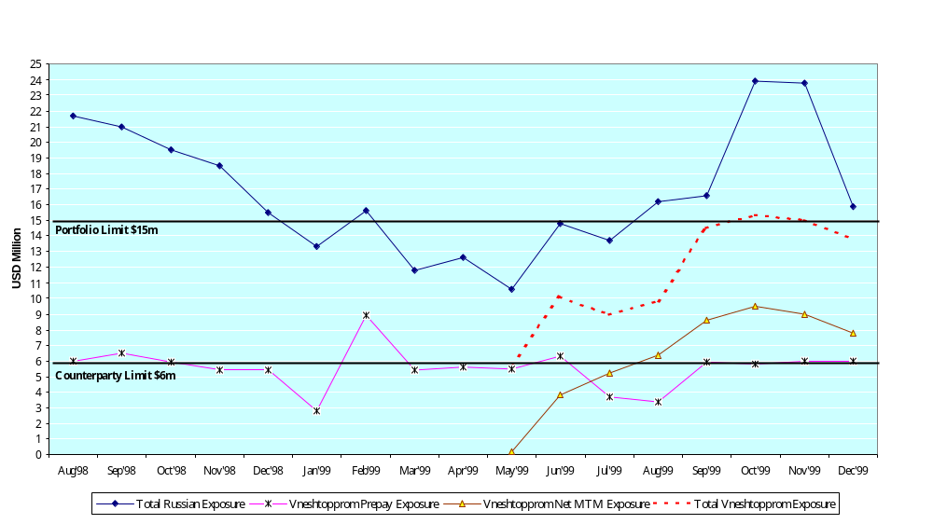
Russian Credit Exposure
Notes:
##
*
*
07/16/96

Slide 6
What Went Wrong?
Over reliance on key commercial individuals
  Lack of seasoned Enron commercial and support staff in Helsinki
  Head of Helsinki trading group able to exert undue influence on controls
  London head of trading group was also key stakeholder in origination effort
  Selective communication of facts by key commercial individuals
Due diligence highlighting material absence of information not referred to in DASH and no formal process for review before changing risk profile
No reference to DASH in funding request - prepayment limit exceeded at acquisition date
Acknowledgement of confirmations and amendments to confirmations/contracts not obtained from pre-finance counterparties (e.g. on rolling forward of undelivered volume)
Lack of appropriate follow-up on Bill of Lading issue after detection in Feb/Mar 99
Prepayment and MTM exposures were not aggregated for management reporting of credit exposure
Volumetric and Valuation reconciliation was not done on a timely basis
Telephone lines in office were not recorded
Notes:
##
*
*
07/16/96

Slide 7
Next Steps
  Pursue negotiations with Vneshtopprom for settlement of outstanding amounts
  Implement revised Helsinki Office business model
  Consider implications of lessons learned
Notes:
##
*
*
07/16/96

